Slide 1
IBM CAPSTONE FINAL PROJECT Predict the Best District for the House Investment Based on the infrastructure facility

Slide 2
Business Problem
Buying a property in Korea is quite challenging because:
House cost is expensive
Future value of the house is hard to predict
The development area that keep change from time to time

Slide 3
Purpose and Constraint
Purpose:
We will answer the main problem: If I want to buy the house right now, where is the best place so my investment can keep growing from time to time.
By using the machine learning technique, we want to help people to predict the best location for the investment easier.
Constraint
We will simplify our study only in the public infrastructure sector and dismiss the political, social, and even economic factors
We only use the data from Wikipedia and Foursquare

Slide 4
Data and Methodology
Data:
List of districts in South Korea (in Korea, it is called -gu)
Latitude and longitude coordinates of those districts.
Population and the area size of each district
Infrastructure data for each district, particularly data related to the subway station, bus stop, bus terminal, hospital, restaurant and school.

Slide 5
Data and Methodology
Mehodology:
Collect the district data from Wikipedia
Collect the population and area size of each district
Collect the latitude and longitude of each district using the Geo Locator
Collect the information about the public facility of each district by using Foursquare
Pre-processing the data
Mapping the data using KNN technique
Conclude the study and give the recommendation

Slide 6
Data and Methodology
Tools:
Run Environment: Jupiter Notebook with Python 3.6
Data analysis tools: Pandas, seaborn, numpy
Location analysis tools: Foursquare API, Geo Locator
Visualization tools: Follium, matplotlib

Slide 7
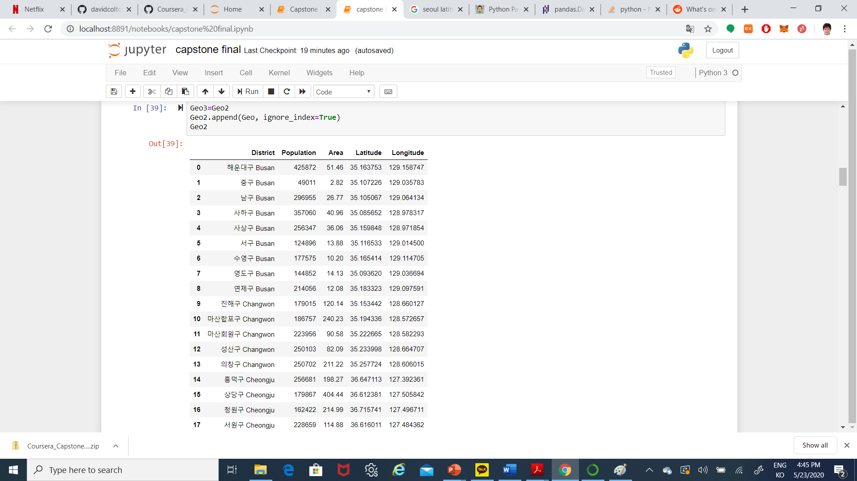
Step 1: Get raw data from Wikipedia

Slide 8
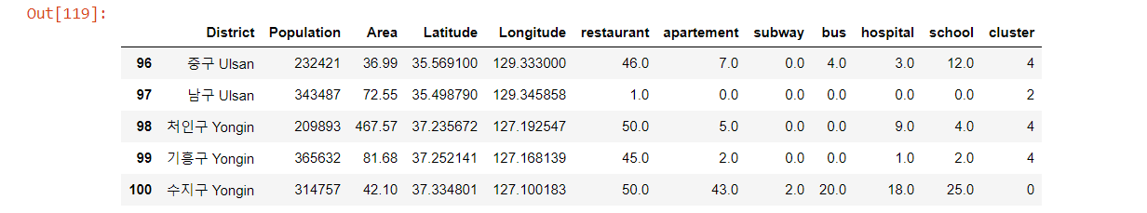
Step 2: Get the List of Facility in each District
Using the Previous Data and Foursquare, we can analyze the number of the facilities in each District
Facilities that we analyze: restaurant, apartment, subway, bus (bus stop), hospital and school

Slide 9
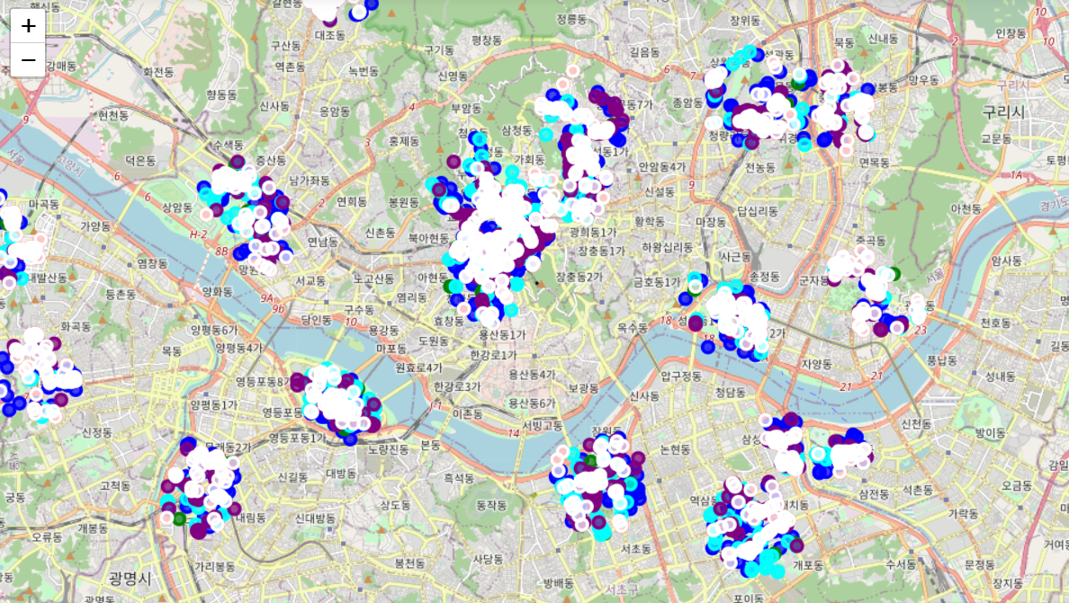
Step 3: Visualize the data
By using the folium, we can analyze the location of each facility in the map
Color reference:
Red: restaurant
Blue: apartment
Green: subway,
Cyan: bus (bus stop)
Purple: hospital
White: school

Slide 10
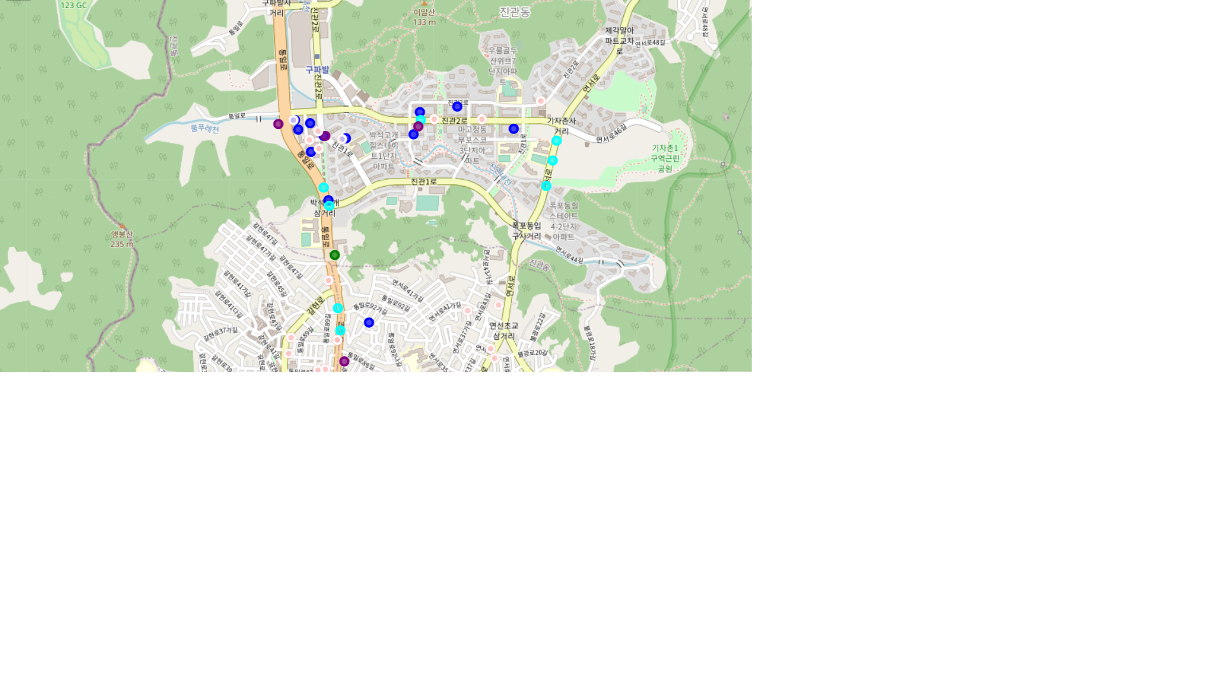
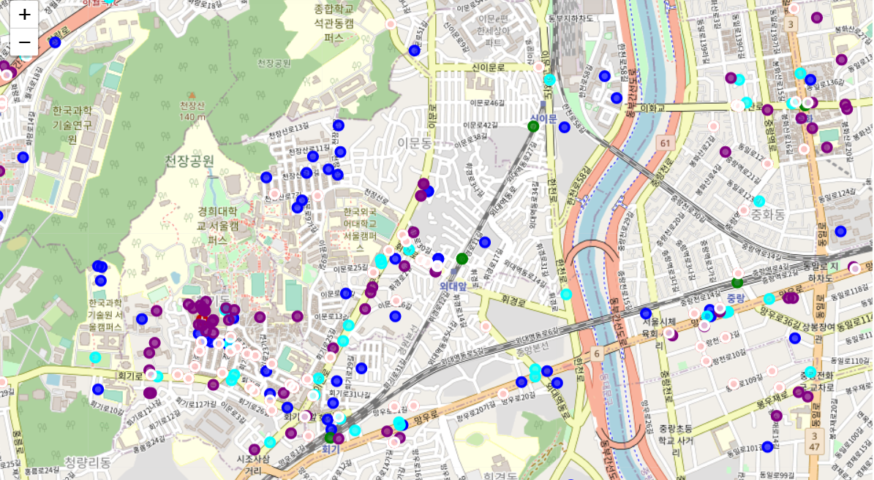
Step 3: Visualize the data
Let’s zoom the data, We take two sample, South west of the Seoul and North east of the Seoul

Slide 11
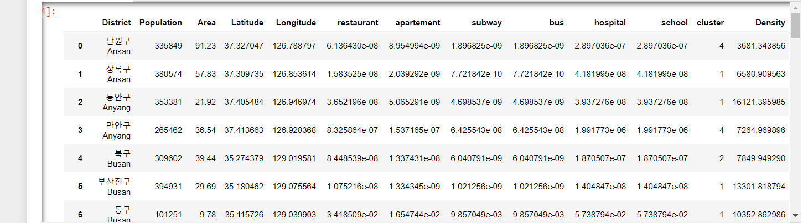
Step 4: Using K-means
Even after zoomed the data, it is too hard to identify what kind of facility that each district has the most
So we will use the K-means cluster to identify it. In this case we will compare the number of the facilities with the population and the area

Slide 12
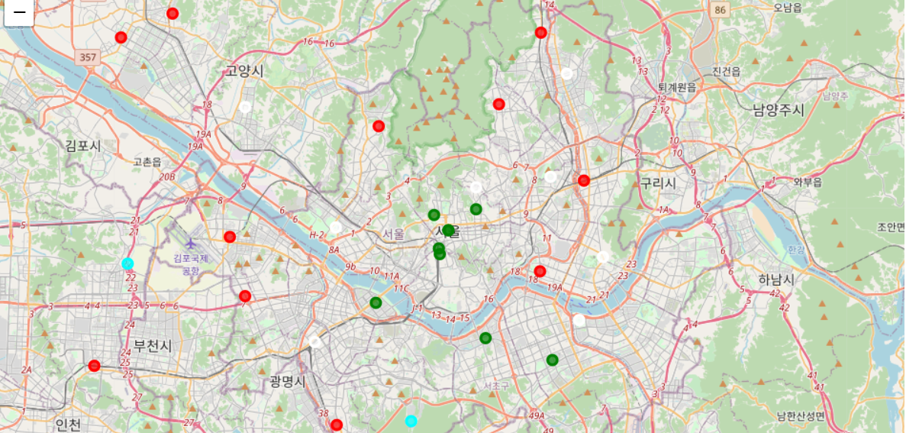
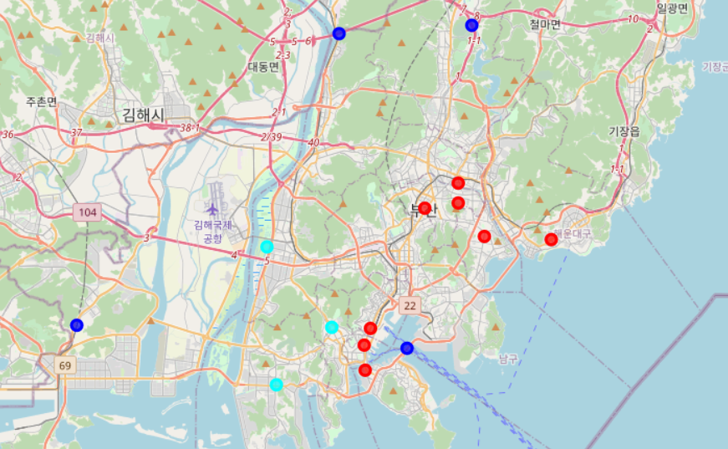
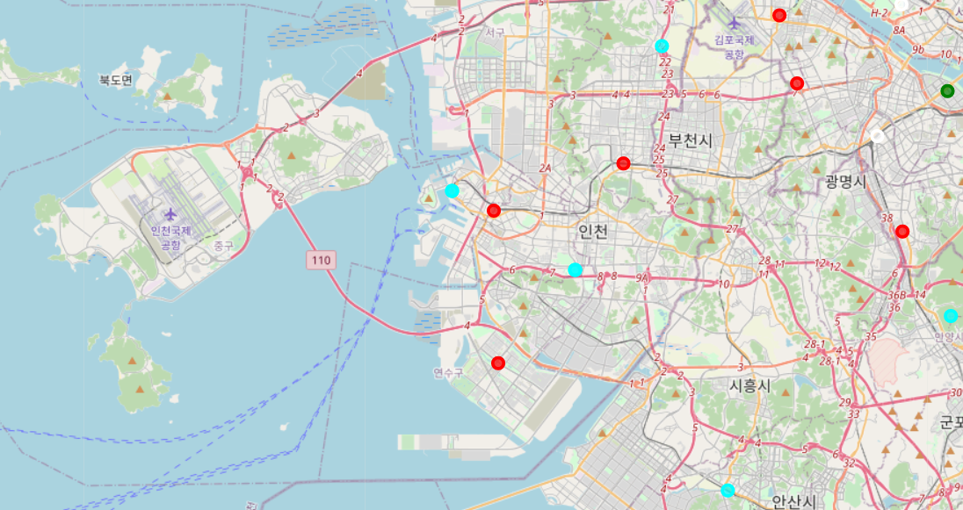
Step 4: Using K-means
So, we can get more simple map, let’s compare what the three biggest city in Korea have most:
Seoul
Busan
Incheon
Red: restaurant, Blue: apartment, Green: subway,
Cyan: bus (bus stop), Purple: hospital, White: school

Slide 13
Step 5: Interpreting the Result
Based on the K means analysis we can assume that:
Most of the District has the number of the Restaurant that quite have a good proportion with the number of the population, therefore almost every area in the big city of Korea is recommended.
The number of the subway station in central Seoul is higher that others, therefore if the buyers must to commute by train, that area is the best place to stay
Overall, the number of the bus in Incheon is higher that others, therefore if the buyers must to commute by bus, that area is the best place to stay

Slide 14
Discussion
The K means can simplify the result of the analysis
This result is quite limited because we only analyze the number of the infrastructure compare with the area and population of each district, therefore we need to add more data to make it more realistic
The data in the foursquare is quite limited compared to other provider such as google maps. Therefore it is highly recommended to compare the data from foursquare with another API location provider

